Slide 1
The Enlightenment
Who’s who?

Slide 2
How did the ideas of the Enlightenment change the world?
The Enlightenment was a time when thinkers used the ideas of the past to analyze their status in the world.
Question: What does the phrase “all men are born free and equal mean to you?”

Slide 3
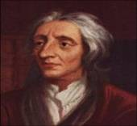
V.I.P’s of the Enlightenment: John Locke
People were reasonable (though still selfish) and had the natural rights to life, liberty, and property.
Purpose of government is to protect these natural rights.
Government power comes from the consent of the people.
Do you agree with Locke’s belief that “… all men are created free and equal?”

Slide 4
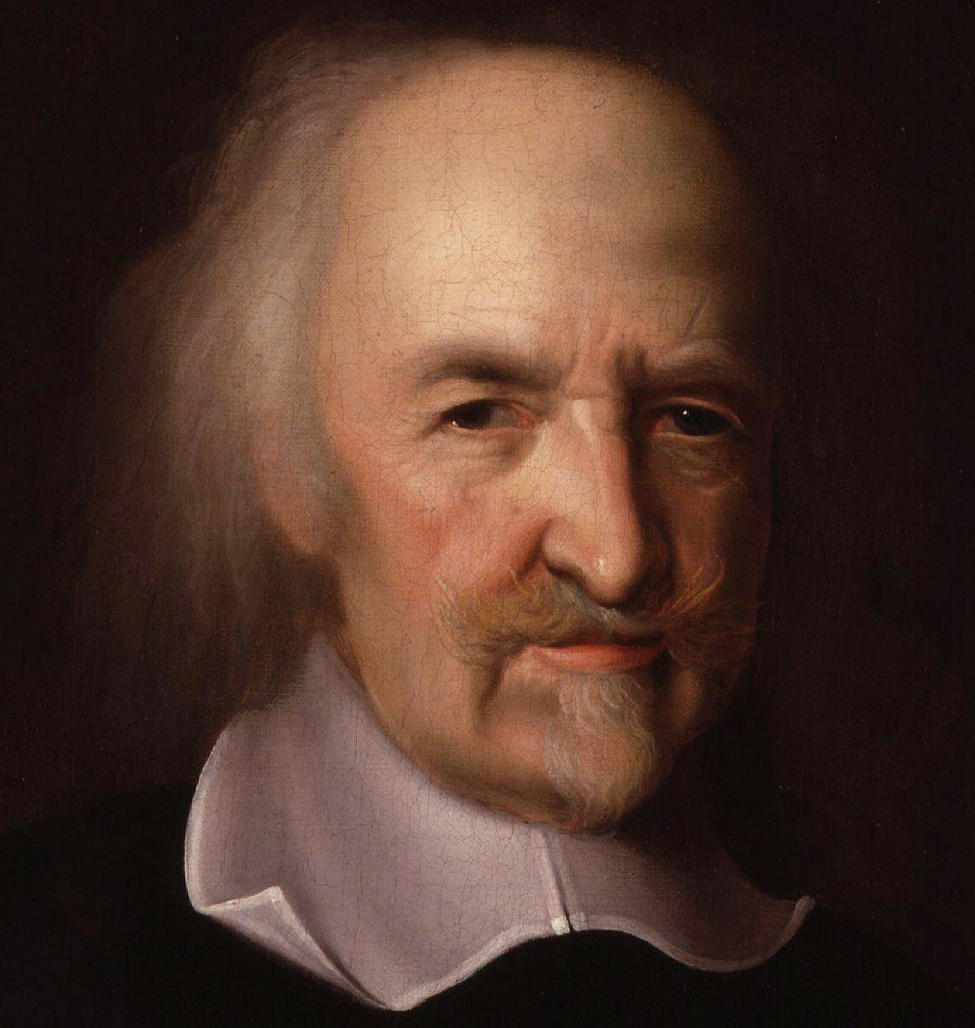
Thomas Hobbes
All humans were naturally selfish and wicked, therefore governments must keep order.
People should hand over their rights to a strong ruler. This was what Hobbes called a social contract.
Strong ruler should have total power (an absolute monarchy).

Slide 5
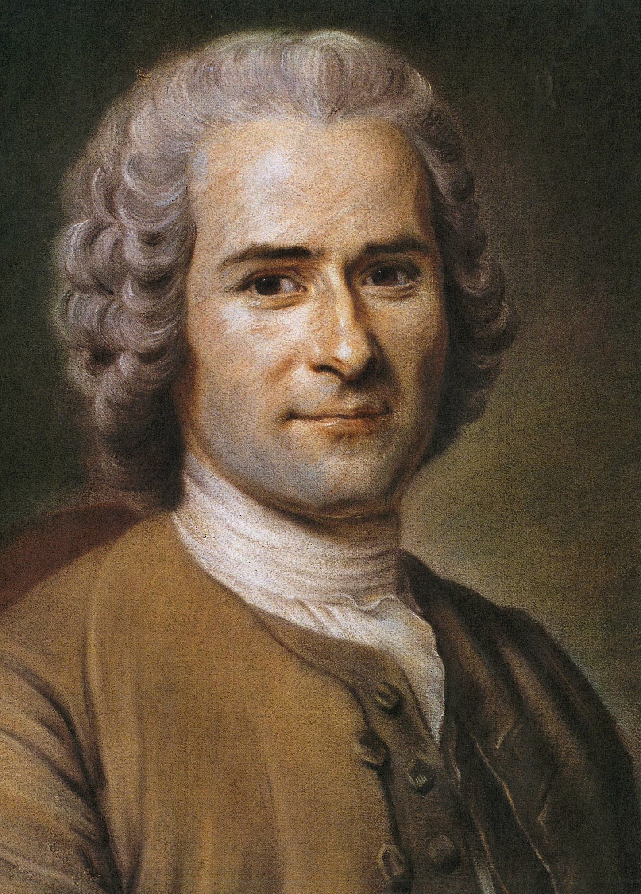
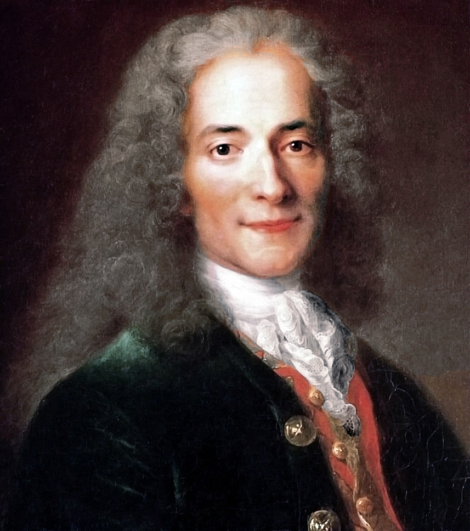
Voltaire
Jean-Jacques Rousseau
Passionately committed to individual freedom.
Believed man was born free and good but easily corrupted.
Believed the only good government was the “general will” or direct democracy.
Question: What do you think Rousseau meant by his statement that “…man is born free and everywhere he is in chains”?
Voltaire was an Enlightenment playwright
Voltaire was the first person to endorse the idea of free speech
Question: Do you believe that free speech is an important right for people to have?

Slide 6
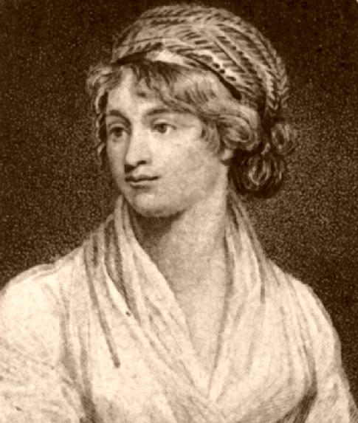
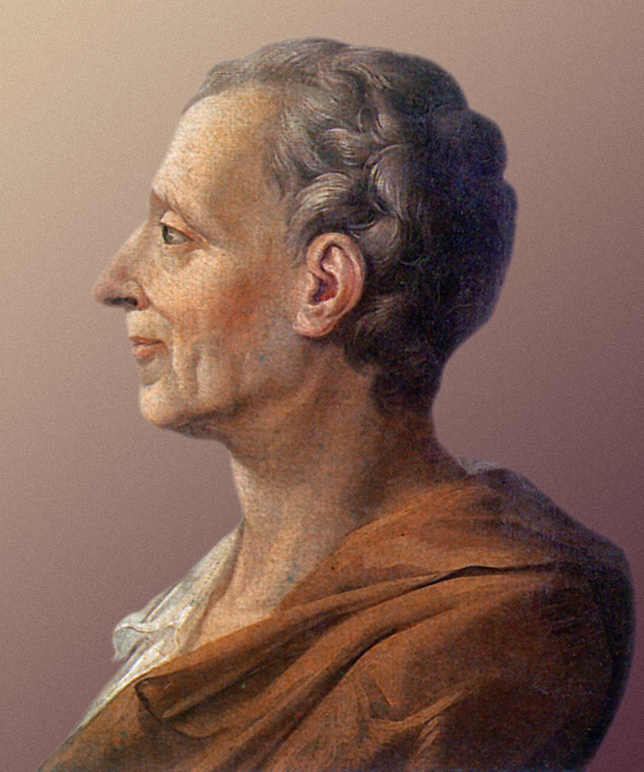
Mary Wollstonecraft
Montesquieu
Mary Wollstonecraft was an especially unique Enlightenment philosopher because she was a woman.
She advocated for equal education for all people (male and female).
Question: How do her ideas affect you today?
Montesquieu believed that all of the power of a government should not rest in the hands of a single person.
He encouraged “Separation of Powers.” (checks and balances)

Slide 7
Assignment: Create an ALL ABOUT ME Poster for a Philosopher
REQUIREMENTS: You will create an ALL about Me poster for one of the Enlightenment philosophers.
A. Done on looseleaf or white paper to be turned in—NO NOTEBOOK.
B. What are they best known for? Write 2-3 sentences explaining.
C. Illustration-art skills do not matter; just try.
D. Why did this person make a difference in the world? 2-3 sentences explaining.
NEATNESS AND APPEARANCE COUNT ☺

